Slide 1


An AIoT Solution to prevent SIDS
– Sudden Infant Death Syndrome
Abhishek Herbert Samuel – 21011102004
Aman Bhat – 21011102013
Sashank Kumar Kakaraparty – 21011102043
B.Tech CSE – IoT A
Phase 1 - Final year project
Mentor – Dr. S.Vidhusha
Shiv Nadar University Chennai

Slide 2
Motivation –
SIDS – sudden infant death syndrome, also known as crib death, is the unexplained death of an infant, typically during sleep, and is the leading cause of mortality in infants aged 1 month to 1 year and is characterized by abnormal breathing, irregular body temperature and suffocation.
SIDS remains a critical concern for parents and healthcare professionals due to its unpredictable nature. Despite advancements in healthcare, SIDS continues to affect infants worldwide, causing significant distress and loss.
The motive behind our project is to blend Artificial Intelligence(AI) and Internet of Things(IoT) technologies to develop a solution that can monitor and analyse infant behaviour in real-time by providing early warnings.
By providing real-time monitoring and alerts, our solution aims to reduce anxiety for parents and caregivers, allowing them to respond quickly to any potential risks, thereby creating a safer environment for infants during their sleep.

Slide 3



Slide 4
Problem Statement –
Our project addresses the critical issue of SIDS, which is a significant risk to infants aged 1 month to 1 year, often occurring during sleep without any prior warning.
The lack of real-time monitoring of vital signs and movements can lead to delayed responses in emergencies, increasing the risk of mortality.
The proposed system aims to provide continuous monitoring and immediate alerts to parents and healthcare providers, thereby enhancing infant safety and reducing the incidence of SIDS.
The challenge lies in the inability to monitor vital signs and detect critical changes in an infant's condition during sleep, and by developing a comprehensive monitoring system that utilizes Artificial Intelligence and Internet of Things to provide real-time alerts.
The proposed solution is designed to be a wearable that has sensors embedded to collect the essential data.

Slide 5
Proposed Solution –
We have divided our approach into two aspects which involves integrating sensors on the crib as well as design a PCB based smart band that too will consist some other sensors.
A printed circuit board (PCB) is a board that connects and holds electronic parts using thin copper lines. These lines let electricity flow between the parts, allowing them to work together. Components are attached to the board, making it easy to mount everything securely inside a device.
With respect to the smart-crib we plan to integrate a camera on the crib.
With respect to the smart band, we plan to develop one which will be placed on the baby’s wrist.
This smart band will be based on the PCB design whereas the SPO2 sensor, temperature sensor and the heart-beat sensor will be the main components of the band.
The radiations will be negligible and will not affect the infant’s health, hence safe for use.

Slide 6
Hardware Requirements –
Max30100 – It is an integrated pulse oximetry and heart-rate monitor sensor solution. It combines two LEDs, a photodetector, optimized optics, and low-noise analog signal processing to detect pulse oximetry and heart-rate signals.
IR Contactless Temperature sensor (MLX90614) – For measuring the current temperature of the baby.
MAX30100 Pulse Oximeter and Heart Rate sensor –
Radiation: very low and safe for use.
Power consumption: pulse oximetry module – 600uA, heart rate module – 1.1mA MLX90614
IR Temperature Sensor – Radiation: no radiation emitted by the sensor and Power consumption: 1.5mA
ESP32 – Microcontroller that provides many GPIO pins that facilitate connection with and control of external devices and sensors. Provides wireless Wi-Fi and/or Bluetooth connectivity for embedded devices.

Slide 7
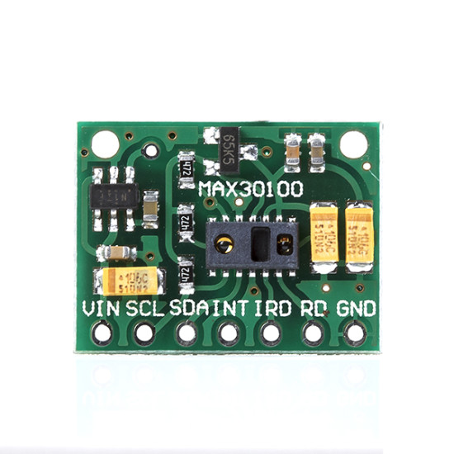
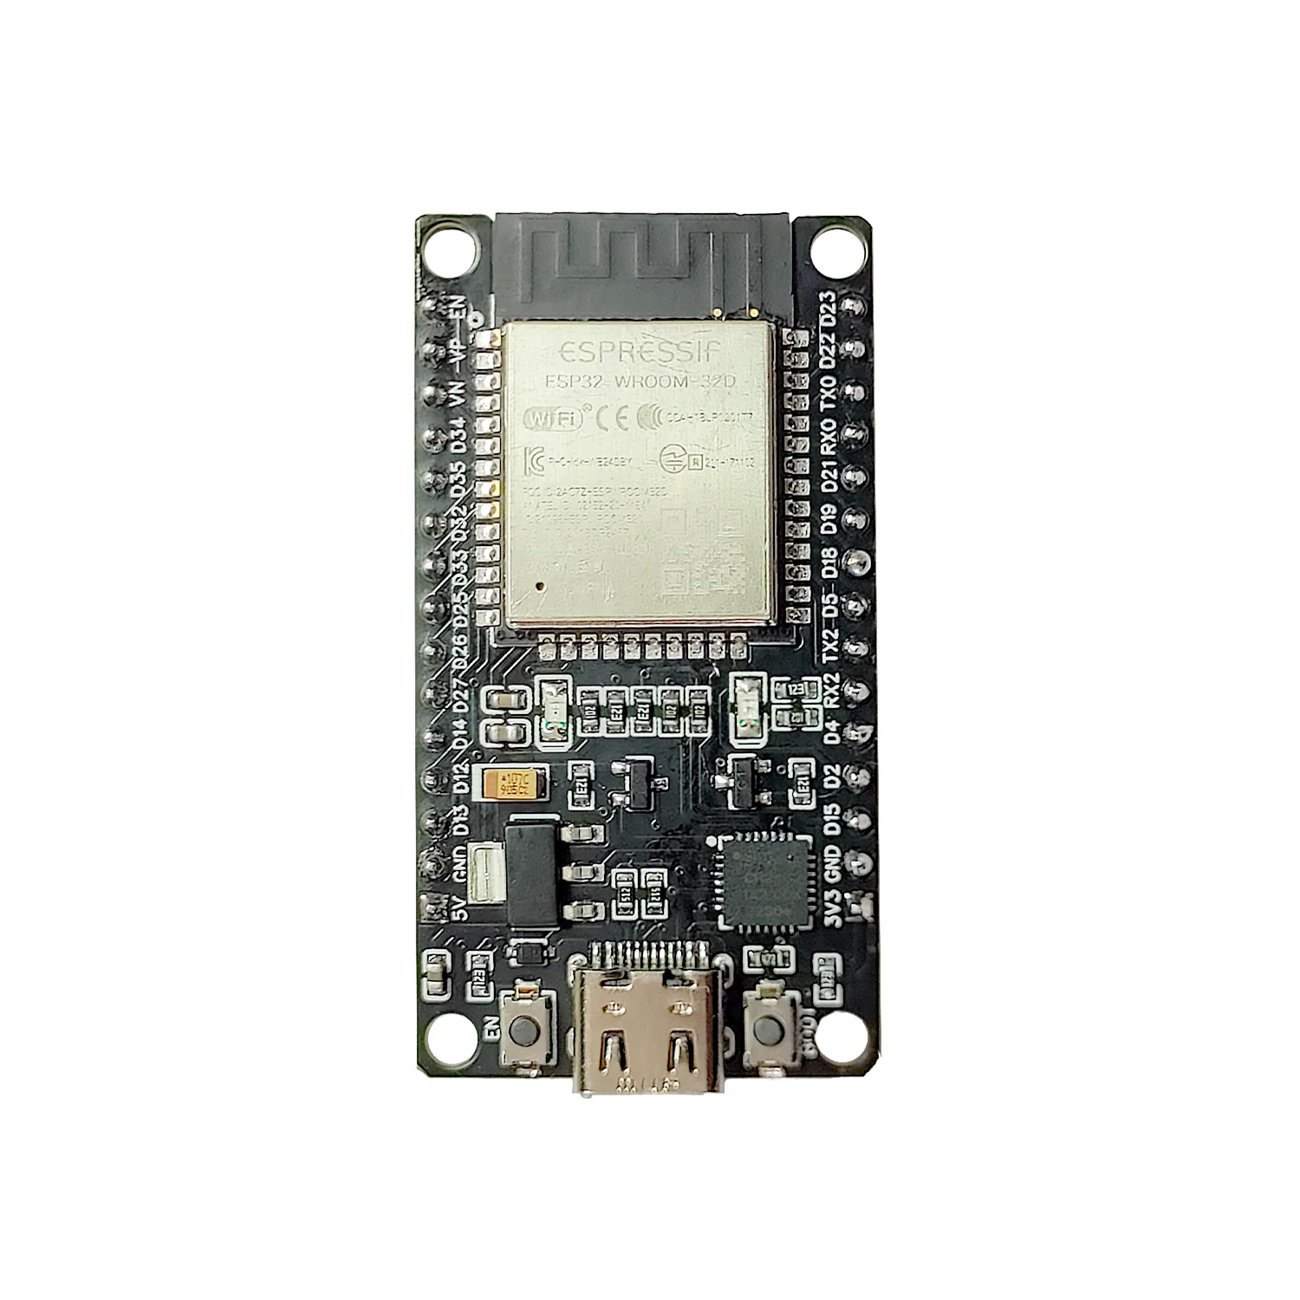
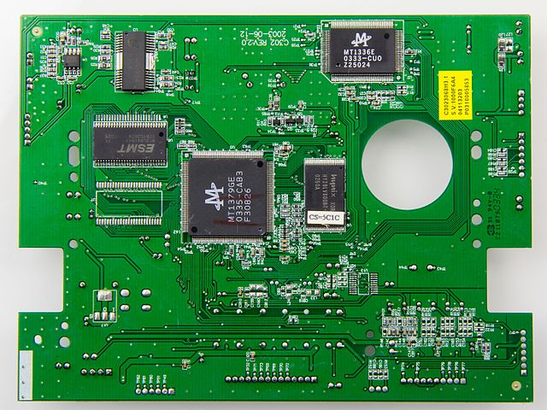
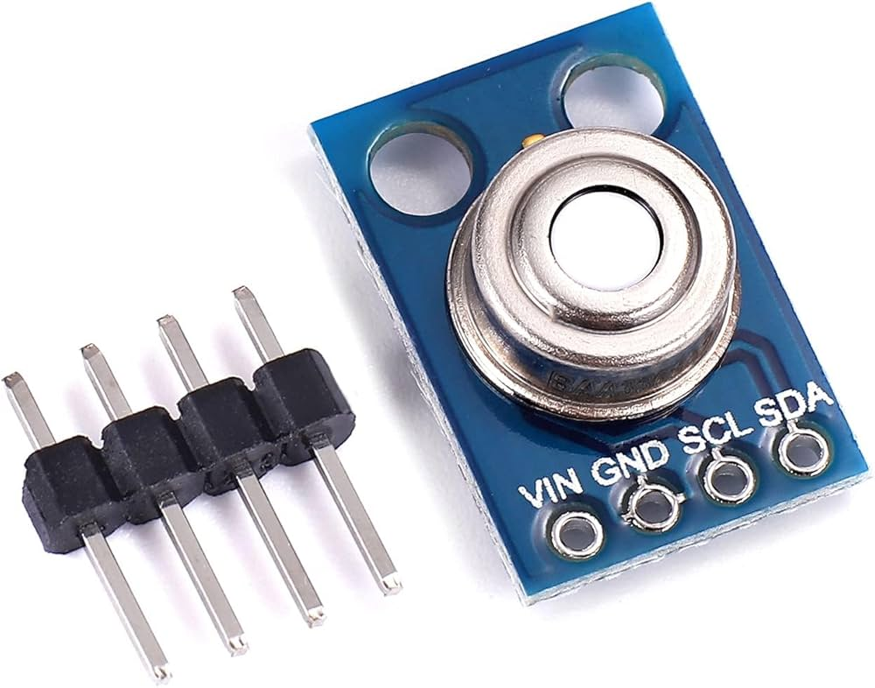
1
2
3
1. Max30100 2 . ESP32 3. PCB 4. MLX90614
4

Slide 8
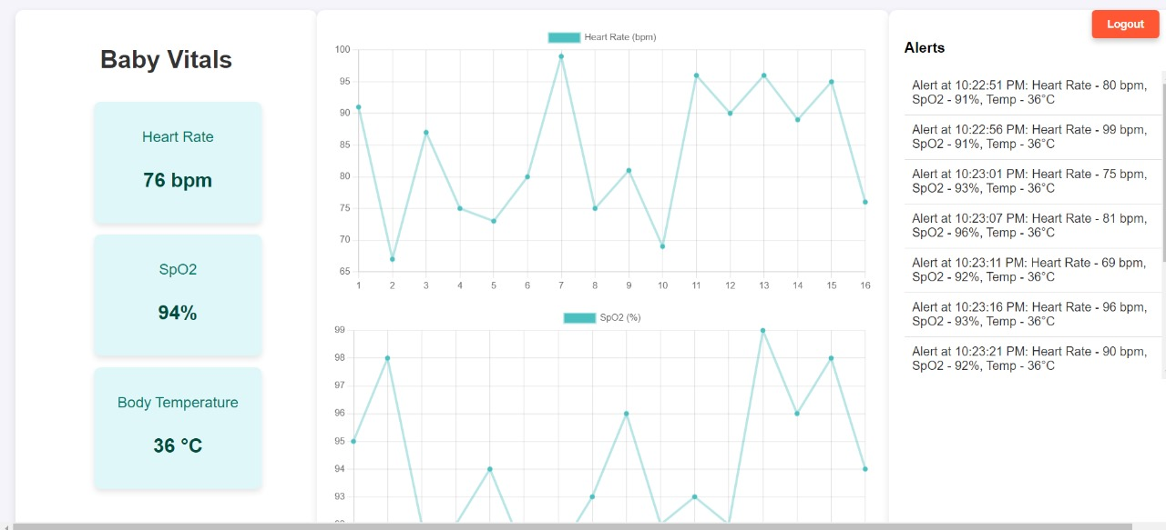
Software –
Programming for ESP32, developing an application to display infant’s health parameters.
Frontend: React Native
Backend: Express.js
Database: MySQL
CI/CD: GitHub

Slide 9
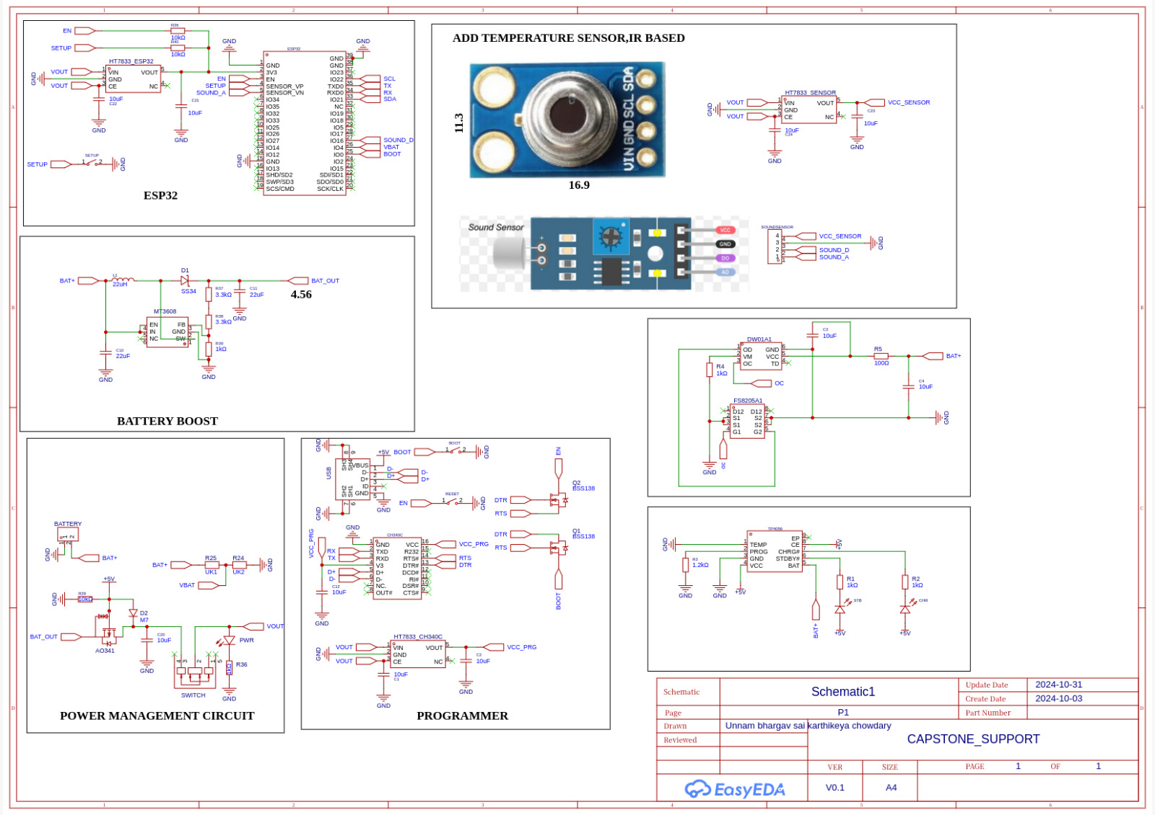
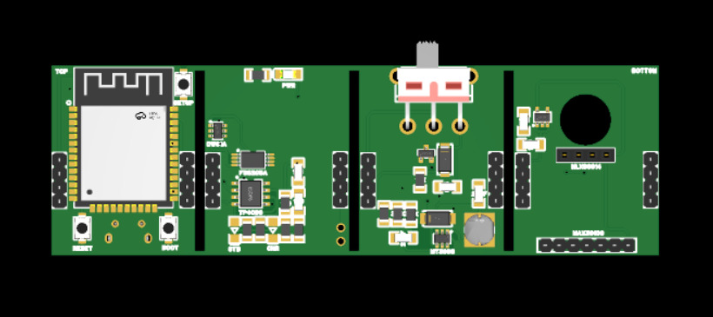
Dimensions – 3.5cm x 2.5cm
Proposed Architecture -
A 4 layered architecture is implemented
Top Layer: ESP32(8 MB) and Programming Circuit.(CH340C,micro usb,reset,boot and setup buttons)
Second Layer: Power Management Circuit.(MT3608 buck boost,A3041 N-channel Mosfet,diodes,22v inductor)
Third Layer: Charging Circuit which offers dynamic charging method.(TP4056)
Bottom Layer: Temperature Sensor and spo2,heart rate sensor.(I2C to communicate with esp32)

Slide 10
Implementation –
The implementation begins with the initialization of components, where a serial connection is established at a baud rate of 115200 for debugging output.
The system connects to WiFi using the provided SSID and password, waiting for a successful connection.
The MLX90614 temperature sensor is then initialized, with an error displayed and the program halted if initialization fails.
Moving into the main loop, data collection takes place by reading body temperature from the MLX90614 and heartbeat and SpO2 levels from the MAX30100 sensor.
Following data collection, a JSON payload is constructed, containing formatted strings for heart rate, SpO2, and body temperature readings.
Before sending this data to the server, the system checks if it is still connected to WiFi and creates an HTTP POST request to transmit the JSON payload to the backend server.
Upon receiving a response, it prints the server's response on success or displays an error message on failure. This process repeats every 3 seconds, ensuring continuous monitoring of vital signs.

Slide 11
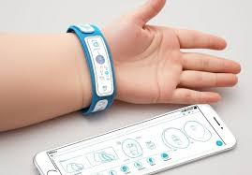
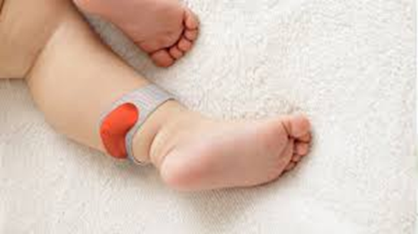
Advantages –
We have implemented the no-contact approach which offers the following advantages -
Single piece of hardware to measure multiple vital signs.
Real - time high precision monitoring and timely alerting.
Portable and Affordable - can be used during transport and replaceable.
Easy to use.

Slide 12
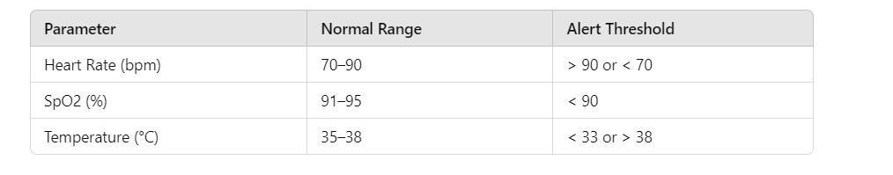
Key Features -
Advantages of the wearable –
Our wrist band will allow us to monitor them remotely while they are sleeping.
This allows us to know instantly when something is wrong after detecting abnormalities in a measured heartbeat or breathing pattern.
MAX30100 Pulse Oximeter and Heart Rate Sensor:
Radiation: very low and safe for use
Power consumption:
pulse oximetry module - 600uA
heart rate module - 1.1mA
MLX90614 Infrared (IR) Temperature Sensor:
Radiation: no radiation emitted
Power consumption: 1.5mA

Slide 13
Result –
Our system provides real-time outputs for heart rate, SpO2, and body temperature via a serial monitor.
Express backend initializes CORS, connects to a MySQL database, and configures WebSocket for updates. It collects sensor data through POST requests, validates it, and broadcasts updates to clients.
The dashboard retrieves the latest data on GET requests, supports user registration and login with password hashing, and listens on a specified port.
React framework at the frontend manages sensor data and alerts, establishes a WebSocket connection for live updates, provides an option to download the data in Excel format and dynamically updates charts while also handling user logout and effectively displays vital signs and alerts in the UI.

Slide 14

Future Scope -
Our goal for phase 2 is to enhance our solution by placing a camera on the crib to capture the position of the infant 24*7 and implement AI Algorithms to detect abnormal movements and positions and alert the parents through an app.

Slide 15
THANK YOU!!

